Slide 1
BMad at GIC

Slide 2
Why BMad?
Spec Kit
Solid foundation
Average follow through
Solo-dev focused
Quite greenfield focused
Doesn’t integrate well with existing SDLC
OpenSpec
Updating docs is a core tenant
Strict flow & workflow
Tasks are light and under-prescribed
No existing state documentation
Integrates ok-ish with existing software practices
Works ok with green and brownfield
GSD
Very greenfield focused
Solid foundation and good follow through
Plans don’t go to deep prescription
Solo-dev focused
Doesn’t integrate well with existing SDLC

Slide 3
Why BMad?
Agents and Workflows
Strict workflow adherence
Solid Brownfield and Greenfield paths
Prescriptive tasks
Solo-dev focused
OK integration with existing SDLC
Comes with it’s own customisation tooling

Slide 4
Stock vs Customized BMad
Stock
Agents and Workflows
Strict workflow adherence
Solid Brownfield and Greenfield paths
Prescriptive tasks
Solo-dev focused
OK integration with existing SDLC
Comes with it’s own customization tooling
Customized
Agents and Workflows
Scoped workflow adherence
Solid Brownfield and Greenfield paths
Prescriptive tasks
Software team focused
Good integration with existing SDLC
Using the customization tooling

Slide 5
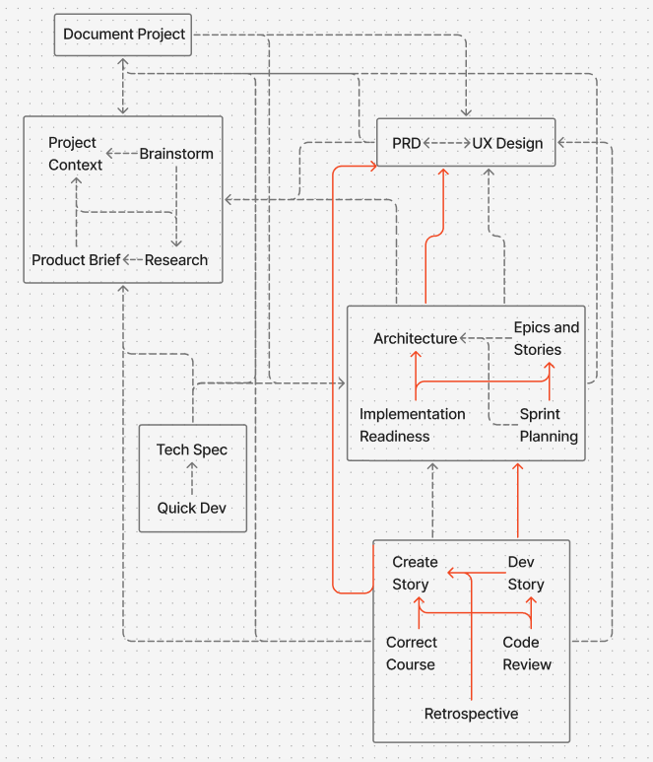
Stock vs Customized BMad
Stock
Document Requirements
and Workflow Order

Slide 6
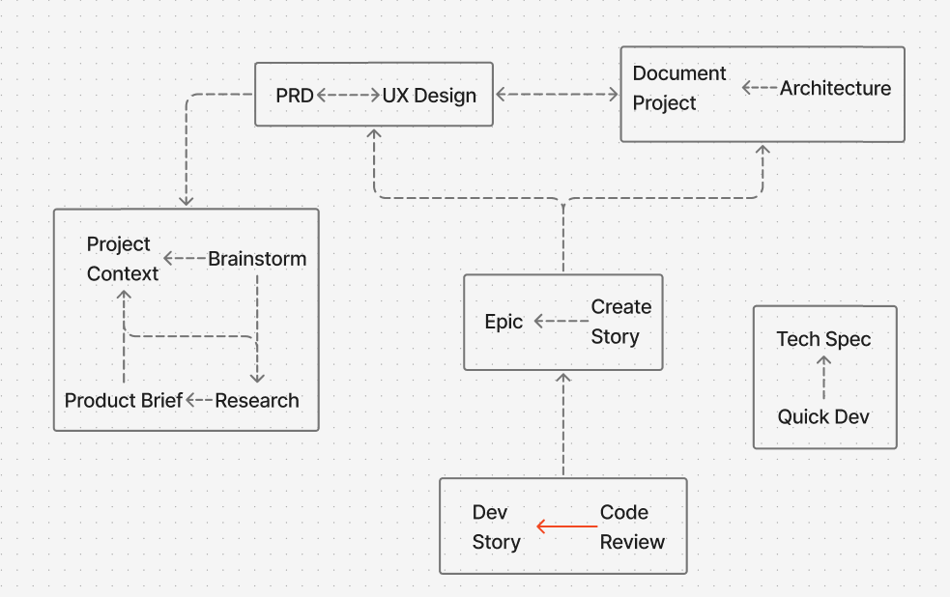
Stock vs Customized BMad
Customized
Document Requirements
and Workflow Order

Slide 7
Stock vs Customized BMad
Don’t push customisation too far, we want to be able to get improvements made by upstream
Workflow conversion to v6
New ideas and processes contributed by the community

Slide 8
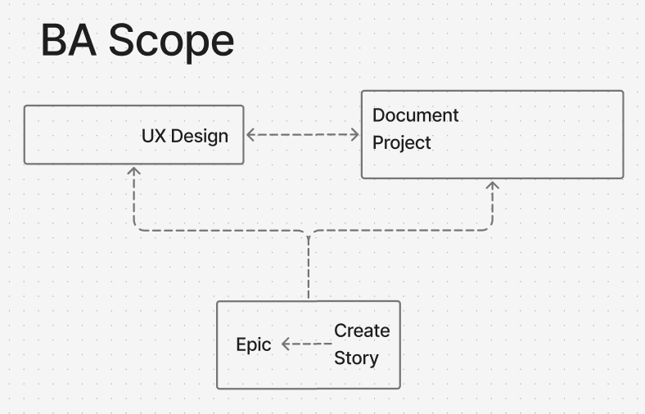
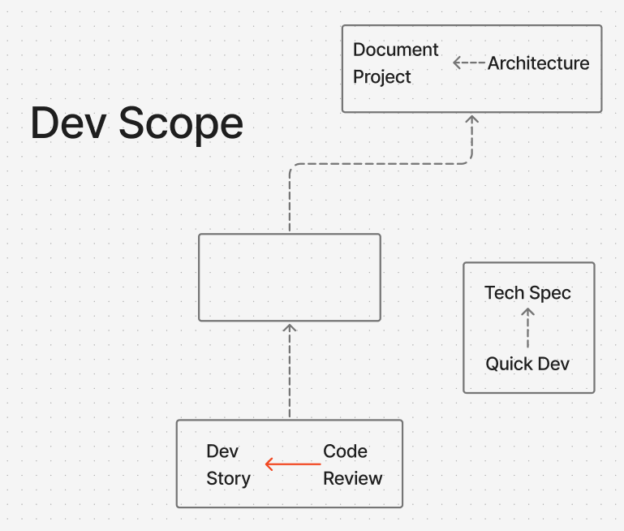
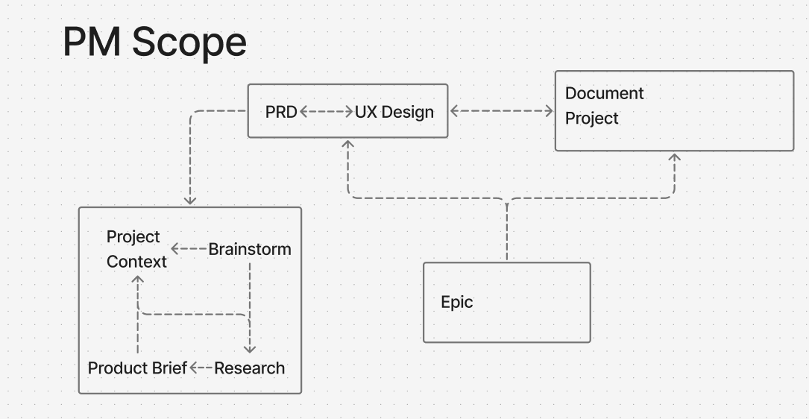
Scopes

Slide 9
BA Workflow
Document Project (analyst)[DP]
UX Design (ux-designer)[CU]
Create Epic (pm)[ES]
Create Story (sm)[CS]

Slide 10
Dev Workflow
Document Project (analyst)[DP]
Create Architecture (architect)[CA]
Implement Work (dev)[DS] (short for dev story)
Code Review (dev)[CR]
Quick Flow:
Tech Spec (quick-flow-solo-dev)[TS] -> Quick Dev (quick-flow-solo-dev)[QD]

Slide 11
PM Workflow
Brainstorm (analyst)[BP]
Research (analyst)[RS]
Create Product Brief (analyst)[CB]
Document Project (analyst)[DP]
Create PRD (pm) [CP]
UX Design (ux-designer)[CU]
Create Epic (pm) [ES]

Slide 12
Best practices
Multi-hat
AGENTS.md
Document each repo/service
copilot-instructions
Commit documentation and agents

Slide 13
Next Steps and Help Me!
How to install
How to contribute

